Slide 1
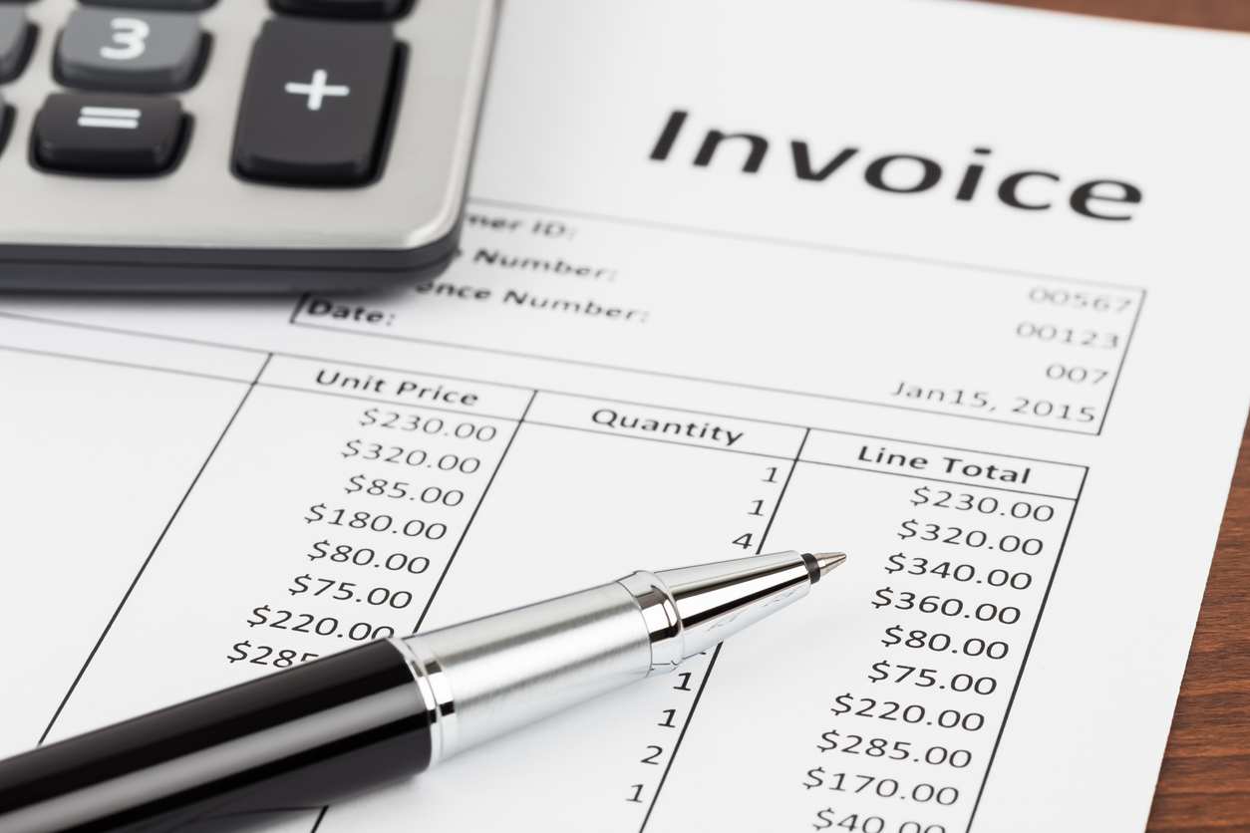
Invoicing
Príloha č. 9
BiOA 4.ročník

Slide 2
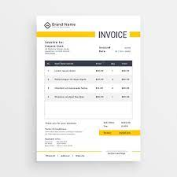
What is invoice?
is a document given to the buyer by the seller to collect payment. It includes the cost of the products purchased or services rendered to the buyer.

Slide 3
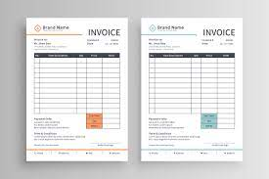
Invoicing
sending an invoice and receiving payment is the final stage in a business transaction
in the retail trade – transactions are usually for cash
in the whole sale and foreign trade – customary to allow credit

Slide 4
Invoices
When goods are supplied on credit, the supplier sends an invoice to the buyer to:
inform the buyer of the amount due
enable the buyer to check the goods delivered
enable entry in the buyer´s purchases day book
sometimes send with the goods, usually mailed separately
What Is Amount Due?
The amount due is the total sum of money owed and to be paid by a set date either to:
The seller of a good or service
A government authority, such as a tax agency
A lender

Slide 5
Task: Create a invoice.
https://create.onlineinvoices.com/templates/blank-invoice-template
use details from an business letter – order that you created
search free invoice generator and use website: www.shopify.com

Slide 6
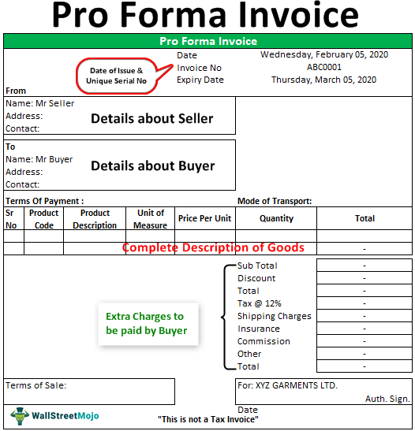
Pro forma invoice
preliminary bill of sale sent to buyers in advance of a shipment or delivery of goods
typically describes the purchased items and other important information (shipping weight, transport charges)
most pro forma invoices provide the buyer with a precise sale price
include estimate of any commisions or fees (applicable taxes, shipping costs)

Slide 7
Pro forma invoice
although it contains exact cost details associated with the sale, it is not an official demand for payment
often used with international transactions, especially for customs purposes on imports (na colné účely pri dovoze)
different from a simple price quotation – it is a binding agreement – although the terms of sale can be changed
there is no exact presentation or format of a pro forma invoice

Slide 8
Why use Pro forma invoice?
used to communicate the expected costs, fees, and date of delivery for an order or product
provides the buyer with an opportunity to negotiate on the terms of delivery
if the buyer is not satisfied with the price, quantity, or delivery timeline, they can contact manufacturer to reach a mutually-satisfactory conclusion
there is no legal requirement to issue a pro forma invoice, it is generally a good idea because it allows manufacturers to avoid disputes at the time of delivery

Slide 9
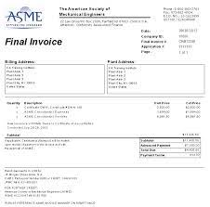
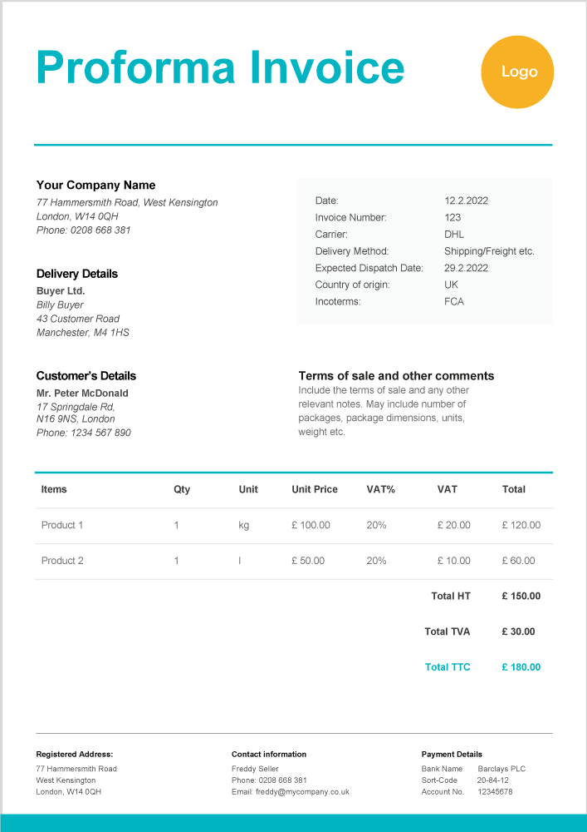
Pro forma Invoice vs. Final Invoice
Pro forma Invoice
Final invoice
a preliminary notification of the terms of a purchase agreement
used to prevent misunderstandings about the amount due
usually issued at the time an order is placed – the buyer can clarify any questions about the price or date of delivery
official commercial instrument
ususally issued at the time of delivery, and constitutes a request for payment by the receiving party

Slide 10
Pro forma Invoice - Example
A bakery customer, for example, might agree to the price of a cake on a pro forma invoice, and the baker will deliver the cake once it is ready. The customer will then pay for it when they receive the invoice. The final invoice amount will be the same or close to the amount on the pro forma invoice.

Slide 11
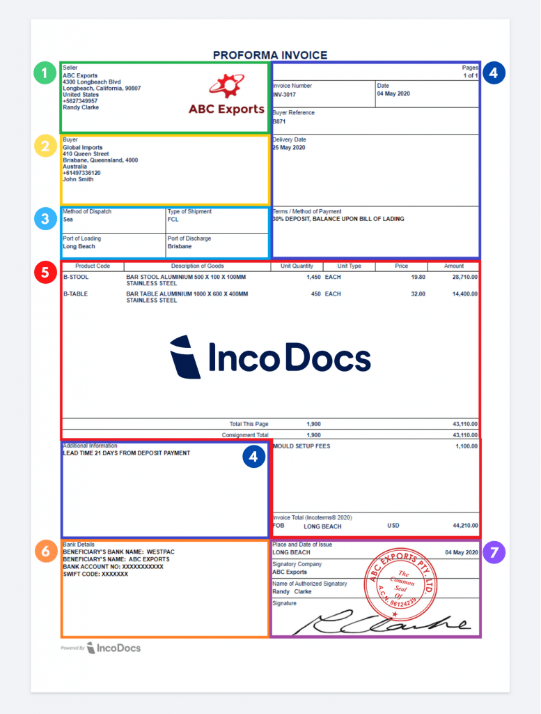
Seller’s Details
Buyer’s Details
Shipping Details
Reference Numbers & Additional Information
Product Details
Bank Details
Authorized Signature

Slide 12
Covering email with invoice
not normally necessary to send a covering letter with a invoice
sometimes, customer requires the invoice to be sent by email, in which case a short and simple note may be sent with it
the invoice informs the buyer of the amount due for goods supplied on credit
Example:
Dear Mr Timms
We attach our invoice number B 832 for the polyester shirts ordered on 13 August.
The goods are available from stock and will be sent to you as soon as we receive the amount shown on the attached invoice, namely £1,342.78.
I hope to hear from you soon.

Slide 13
Task
Your customer requires the invoice to be sent by email. Write a covering email with the invoice.

Slide 14
DEBIT AND CREDIT NOTES

Slide 15
DEBIT NOTE
is a document a seller uses to remind the buyer of current debt obligations
may include information about an immediate payment or may serve as a reminder of current funds due
also known as a debit memo
different from invoices – usually written as letters and do not demand immediate payment
DEBT – sum of money owed by one person to another person

Slide 16
DEBIT NOTE
can also be issued with purchased goods as shipping receipts – payment is not expected before an official invoice is submitted to the buyer – this can give a customer the ability to return goods without first having to make a payment
sent by the supplier to a buyer who has been undercharged in the original invoice

Slide 17
Example: Supplier sends debit note
Dear Mr Lim
I am sorry that an error was made on our invoice number B 832 of 18 August.
The correct charge for polyester shirts medium, is £26.70 and not £26.00 as stated. We are therefore enclosing a debit note for the amount undercharged, namely £14.70.
We are sorry this error was not noticed before the invoice was sent.
Yours faithfully

Slide 18
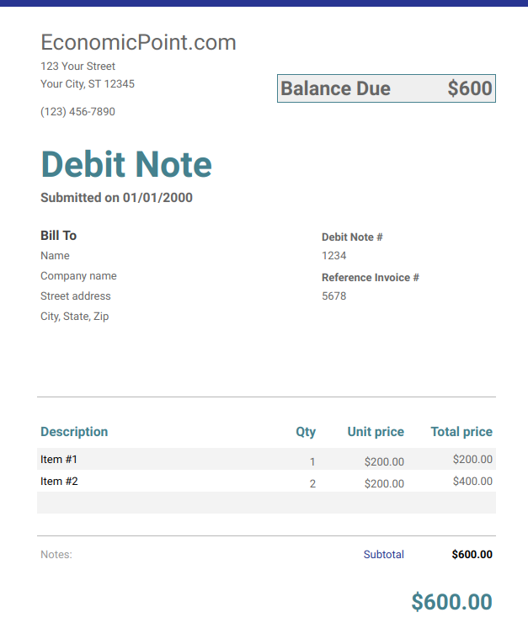

Slide 19
DEBIT NOTE vs. PRO FORMA INVOICE
Debit note is a letter or memo issued by a seller to advice the amount owed by the buyer.
A pro forma invoice is not a true invoice – it is simply a document that declares the seller's commitment to provide the goods or services specified to the buyer at certain prices.

Slide 20
CREDIT NOTE
also known as credit memo
sent by the supplier to a buyer who has been overcharged in the original invoice
usually printed in red
issued to indicate a return of funds if there is an error in invoice, incorrect or damaged products, product cancellation or otherwise specified circumstances

Slide 21
Example: Buyer requests credit note
Dear Sirs
We have today returned to you by rail one empty packing case, charged on your invoice number B 832 of 18 August at £23.25.
A debit note for this amount is enclosed and we shall be glad to receive your credit note in return.
Yours faithfully

Slide 22
